Slide 1
EMPOWERING GIRLS
A Rotary Initiative
Orientation: Zone 22 Region 28

Slide 2
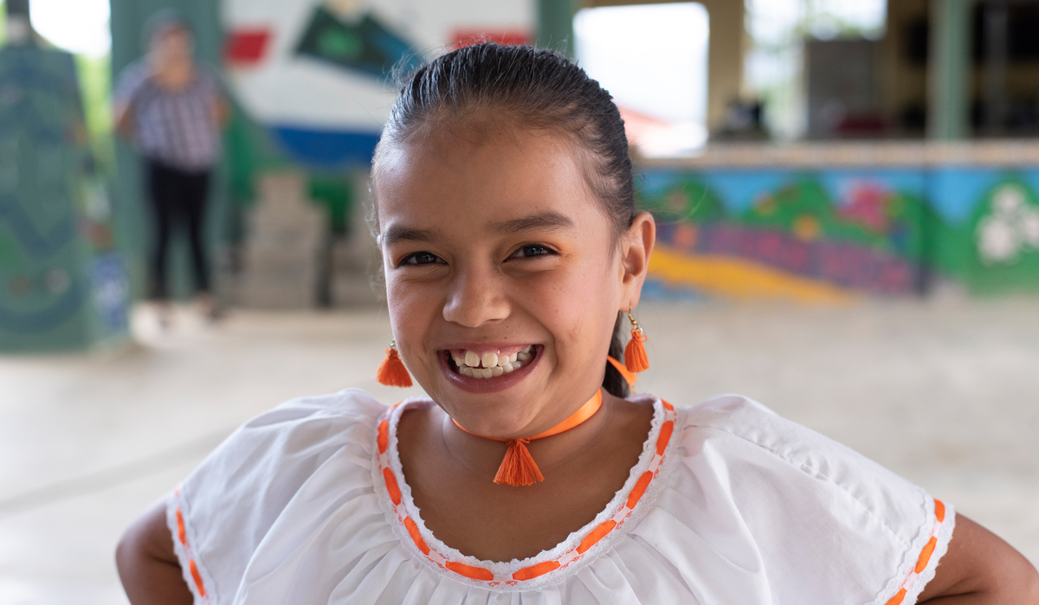
The Empowering Girls Initiative
Why empower girls?
It makes families healthier.
Educated girls have better-educated children and earn higher wages, helping get their families out of poverty.
Women participating in the labor market at the same rate as men would add up to $28 trillion to the annual global gross domestic product in 2025, shares the World Economic Forum.
Every girl should be in charge of her own future. We have an obligation to protect girls’ rights and promote their well-being.
Through the Empowering Girls Initiative, Rotary members worldwide can enhance girls’ safety, health, education, and well-being.

Slide 3
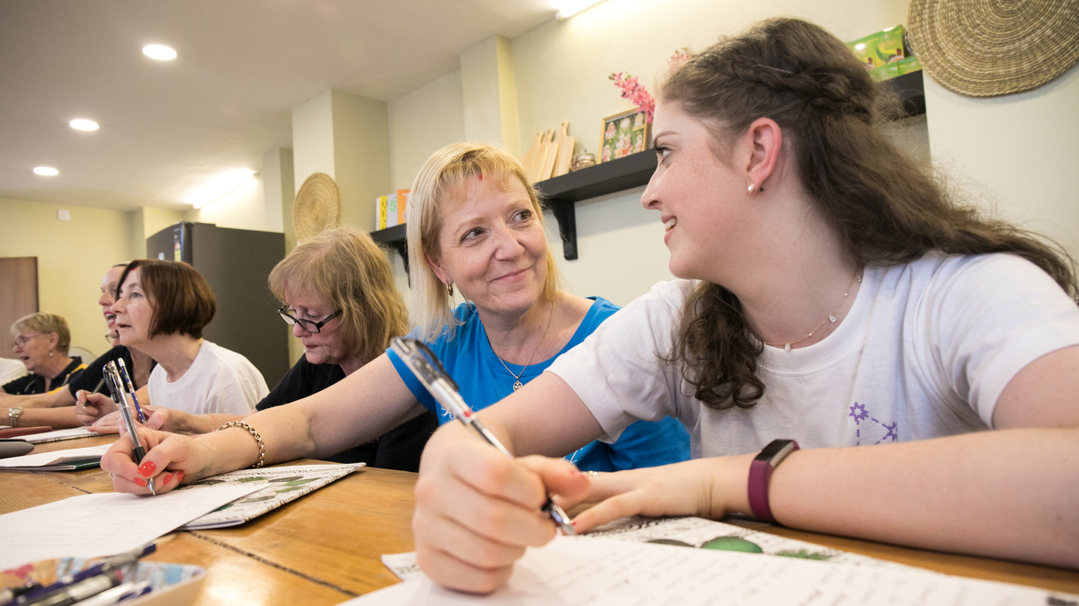
What challenges do girls face in our community?
How can our club work with communities to find solutions to these challenges?
What cultural norms in our area might keep girls from attending school?
Which local organizations can we work with on projects that empower girls?
How can we raise awareness of the need to empower girls within our communities and among our partners?
Does our club empower women to take leadership roles?
WHAT CAN ROTARY DO?

Slide 4
Ways for
Clubs
to participate
Rotary clubs and districts can participate by creating and implementing activities that enhance the quality of life for girls and improves girls’ chances of enjoying safe, healthy, and productive lives. They can also modify existing projects to include components that focus on empowering girls.

Slide 5

Resources
Empowering Girls ambassadors
Advocate for girls’ empowerment.
Act as a resource for clubs and districts.
Collect and distribute success stories.
Opportunities
Visit the RI president’s page to find ways to participate.
Learn more about Rotary’s comprehensive approach to youth protection.
Rotary Action Groups
Find contact information on the RI president’s page.
Connect with action groups that can help.
The Cadre of Technical Advisers
Find an adviser who can help with initiatives to empower girls by writing to cadre@rotary.org.
Rotary Showcase
Find ideas for projects or ways to work with other clubs to empower girls.
Add your service activity or project to the Empowering Girls Campaign.
Partnerships
Work with Rotary partners on projects that empower girls.

Slide 6
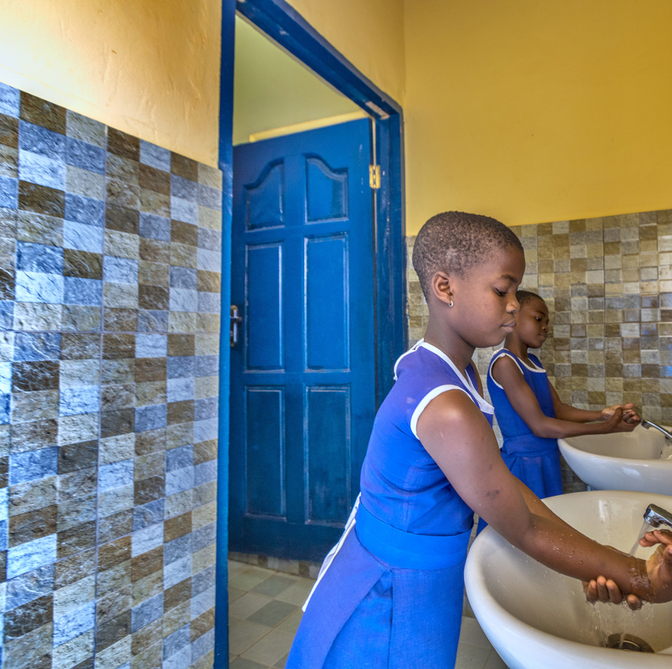
OUR ROLES

Slide 7
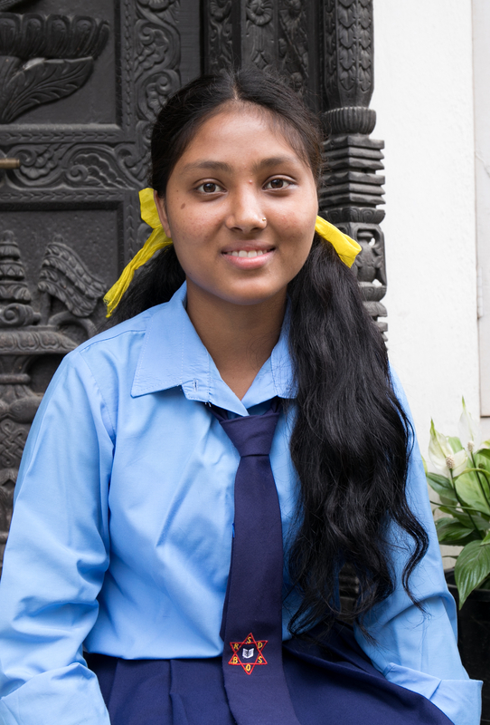
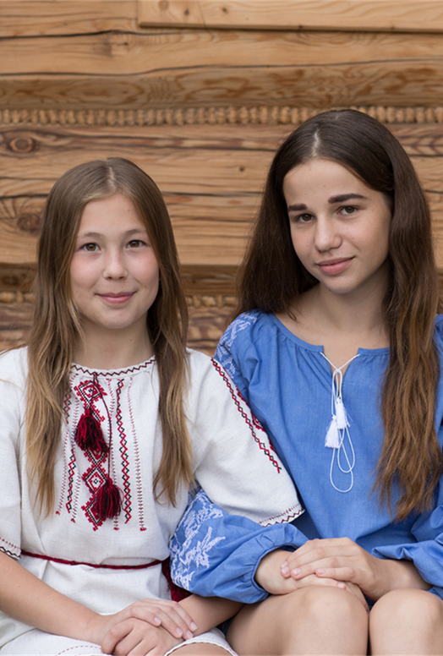

Importance of Partnerships

Slide 8
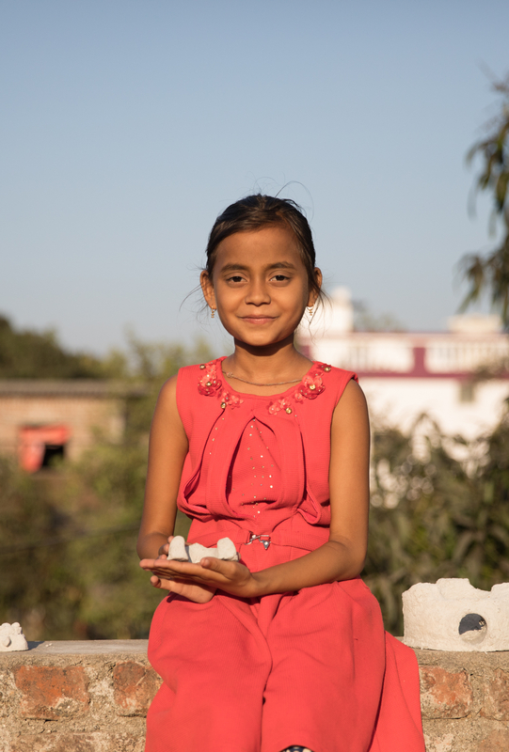

Key Activities of Ambassadors

Slide 9
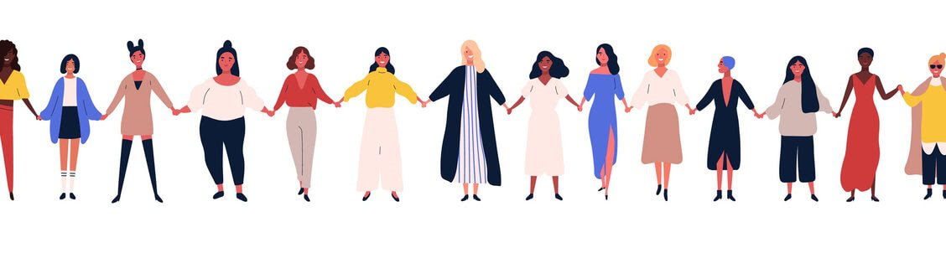
The Next Steps
All resources will be available by the end of July or early August.
We would love for each zone or region to highlight these in an event, either in-person or virtual, such as a webinar, before mid November.
Please also take the Youth Protection course yourself in the Rotary Learning Center, and all your Coordinators in Clubs to take this course.
Encourage and recognize clubs and districts that develop Rotary and community partnerships for Empowering Girls activities.
Encourage clubs to enter their activities in the Empowering Girls Campaign in Rotary Showcase.
Engage with the Ambassadors Facebook Group. You can request to join by following this link to the group: www.facebook.com/groups/629894907971773/
Assistants are also welcome to join this group!

Slide 10
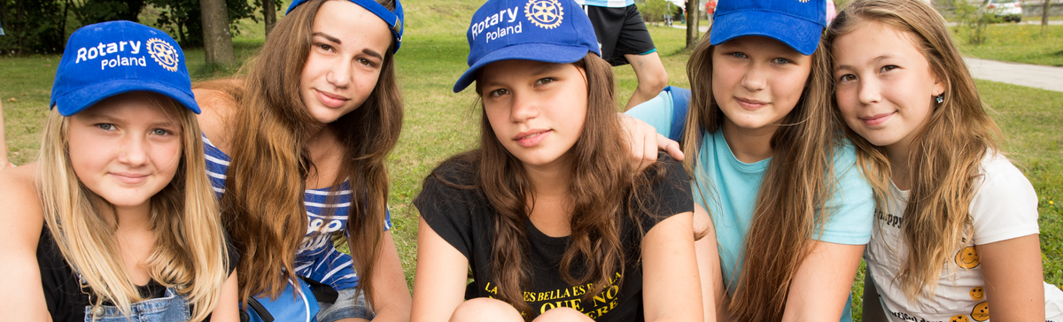
The legacy of empowering girls
The Empowering Girls initiative is Rotary's commitment to making a lasting impact on a generation of girls.
We can make a difference in girls’ lives by:
  Advocating for the public and private sectors to support girls
  Raising awareness of girls’ needs in our communities, our social networks, and our partnerships — as we’ve done with our polio-eradication work

